Slide 1

ProphetIQ - A Saas Website
Submitted in the partial fulfillment for the award of the degree of
BACHELOR OF ENGINEERING
IN
AI & ML
Submitted by:
Team details in the next slide
Under the Supervision of:
Ms. Shubhangi Mishra
Department of AIT-CSE
DISCOVER . LEARN . EMPOWER
1

Slide 2
Our Team
Name | UID
Thiramdas Karthik | 21BCS6034
Chennupati Pavan Sanjay | 21BCS6027
Nimmala Manideep Reddy | 21BCS6087
Guttula Venkata Surya | 21BCS6110
2

Slide 3
Outline
Introduction to Project
Problem Formulation
Objectives of the work
Methodology used
Results and Outputs
Conclusion
Future Scope
References
3

Slide 4
Introduction: The project aims to develop a Software-as-a-Service (SaaS) website that offers stock market price predictions using machine learning algorithms. The website, named "ProphetIQ" will provide users with accurate and reliable predictions to aid in their investment decision-making process. The scope encompasses the development of a user-friendly interface, integration of machine learning models, data security measures, pricing strategies, and customer support mechanisms.
User Interface and Experience: The primary focus of the project is to design and develop a user-friendly interface that provides an intuitive and seamless experience for users.
Machine Learning Models: The core functionality of the website revolves around the integration of machine learning models for stock market price prediction.
Data Security and Privacy: Given the sensitivity of financial data, robust data security measures will be implemented to safeguard user information and ensure compliance with relevant regulations such as GDPR and CCPA.
4

Slide 5
Key Objectives
Objective 1 | Objective 2 | Objective 3
Develop a user-friendly SaaS platform that utilizes machine learning algorithms to provide accurate stock market predictions. | Implement robust data security measures to safeguard user information and ensure compliance with relevant regulations. | Establish transparent pricing strategies and responsive customer support channels to enhance user satisfaction and retention.
5

Slide 6
Methodology
Research and Analysis: Conduct thorough research on existing SaaS platforms in the finance domain, analyze user requirements, and study market trends to inform the design and development process.
Machine Learning Model Selection: Evaluate various machine learning algorithms suitable for stock market price prediction, considering factors such as accuracy, scalability, and computational efficiency.
Data Collection and Preprocessing: Gather historical market data from reliable sources and preprocess it to ensure quality and consistency, including handling missing values, normalization, and feature engineering.
6

Slide 7
Methodology
Model Training and Evaluation: Develop and train machine learning models using historical market data, validate model performance using appropriate evaluation metrics, and fine-tune models to optimize prediction accuracy.
User Interface Design: Design an intuitive and visually appealing user interface, focusing on usability, accessibility, and responsiveness across different devices and screen sizes.
Backend Development: Build the backend infrastructure of the SaaS platform, including database design, API development for model integration, and implementation of data security measures.
7

Slide 8
Methodology
Integration and Testing: Integrate machine learning models with the backend system, conduct thorough testing to ensure functionality, performance, and reliability, including unit testing, integration testing, and user acceptance testing.
Data Security Implementation: Implement robust data security measures, including encryption, access control, and compliance with relevant regulations such as GDPR and CCPA, to safeguard user data and ensure privacy.
Pricing Strategy Formulation: Devise transparent pricing strategies based on market analysis and user feedback, including multiple subscription plans, pricing tiers, and trial options, to maximize user adoption and revenue generation.
Customer Support Setup: Establish responsive customer support channels, including live chat, email ticketing system, and comprehensive documentation, to address user inquiries, resolve issues, and enhance user satisfaction.
8

Slide 9
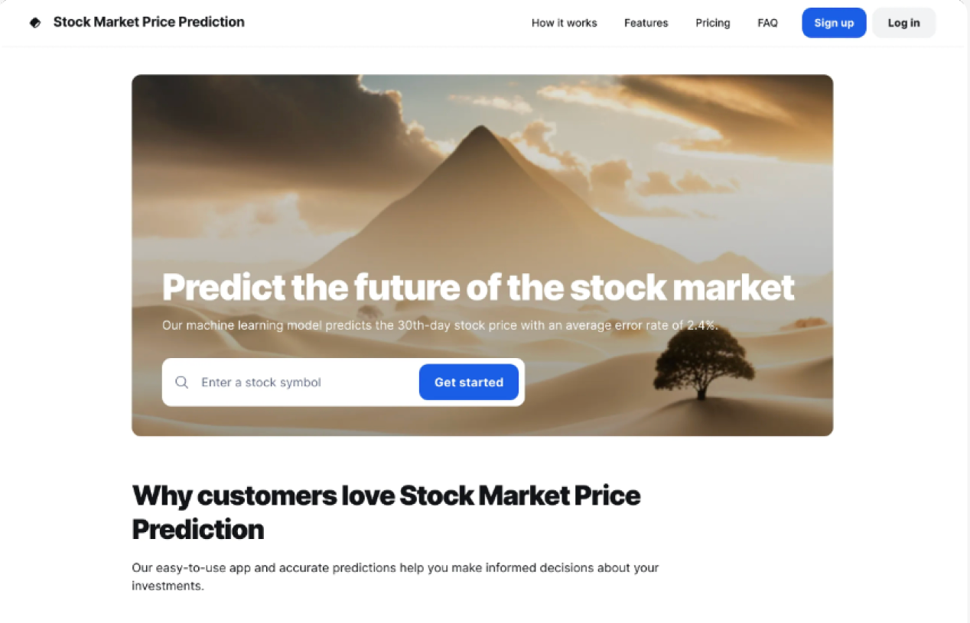
Result
9

Slide 10
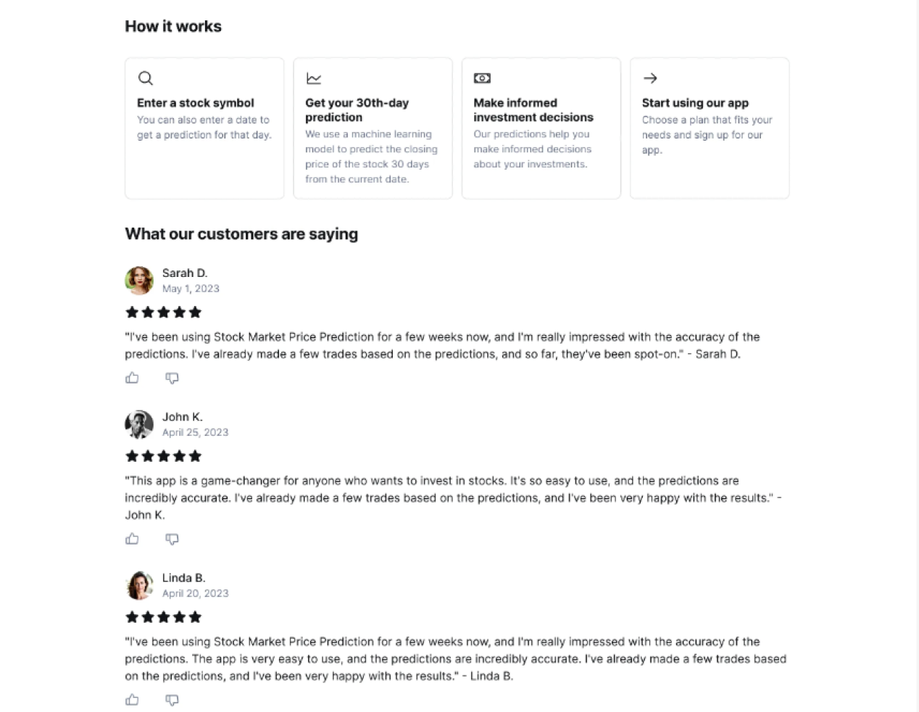
10

Slide 11
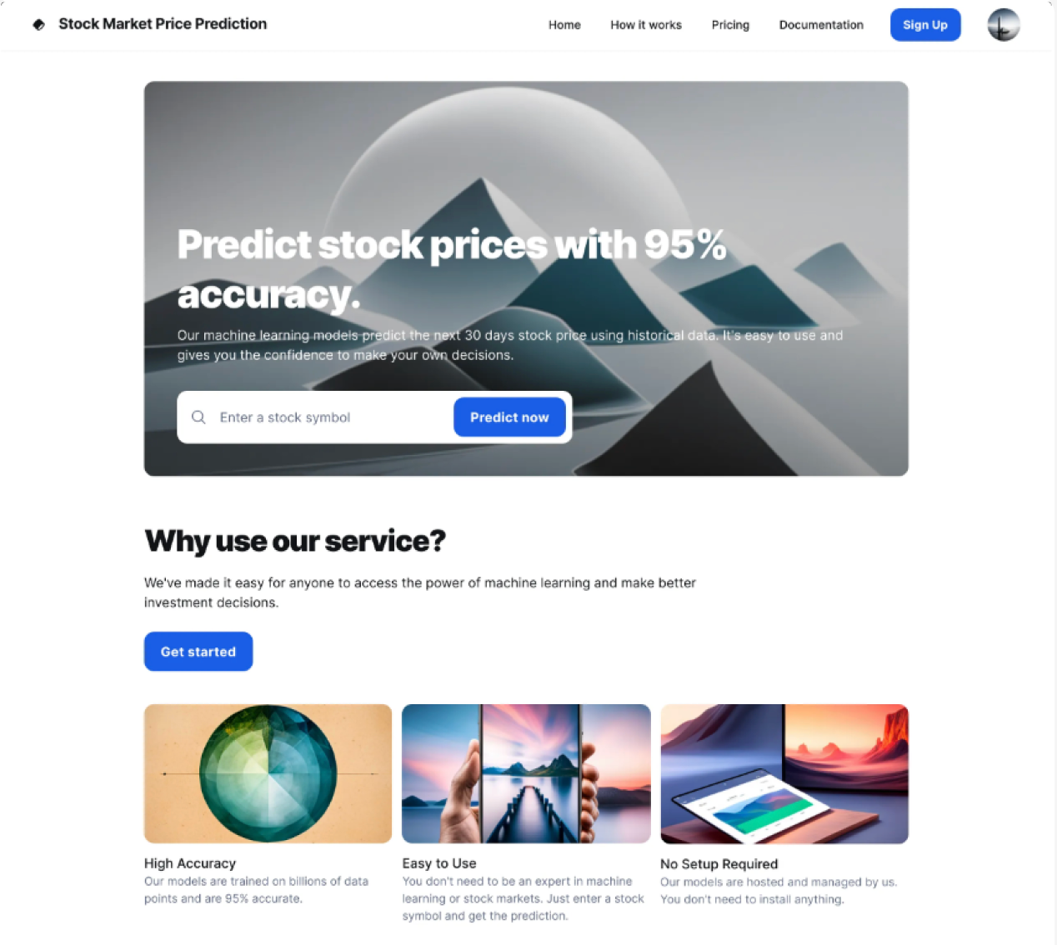
11

Slide 12
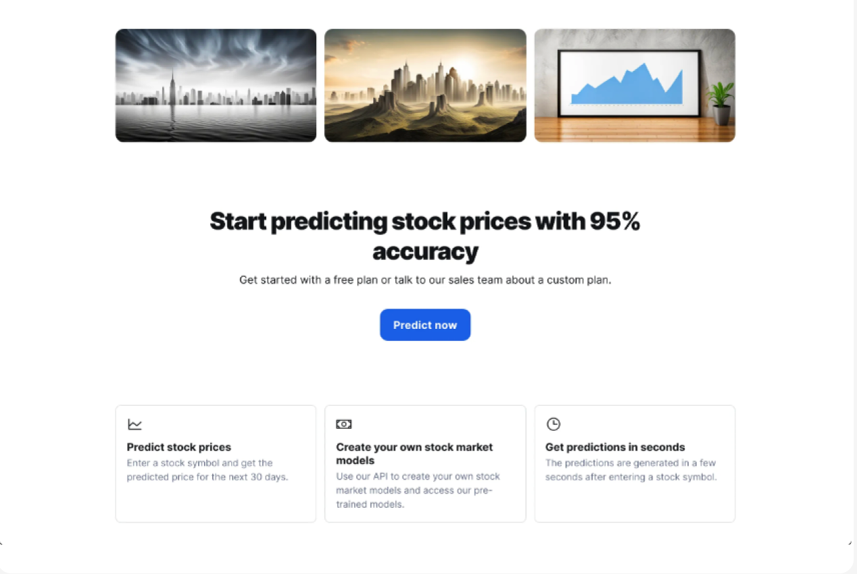
12

Slide 13
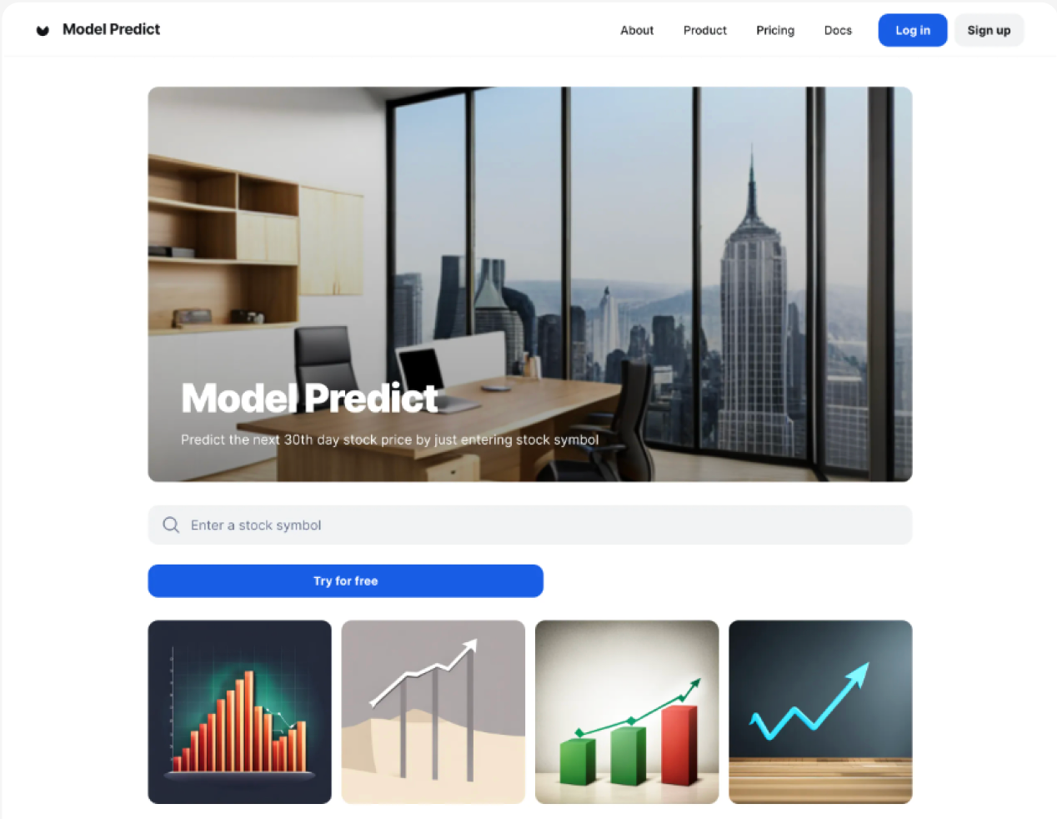
13

Slide 14
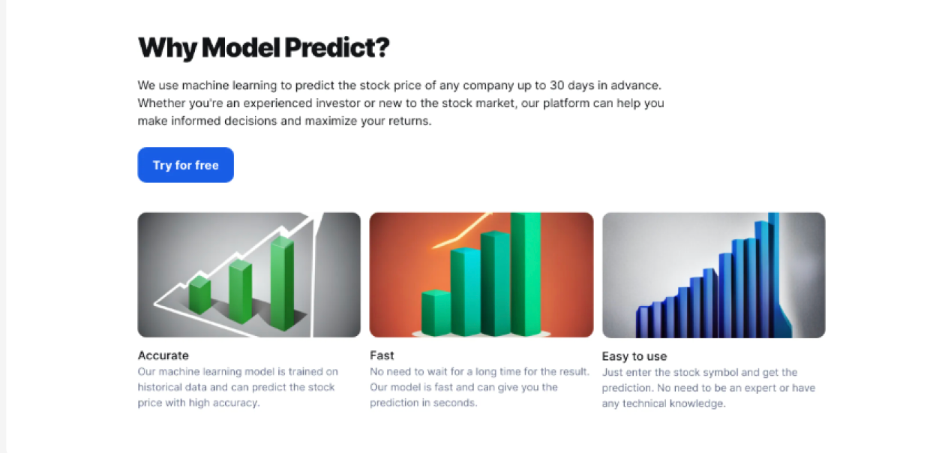
14

Slide 15
Highlights
Innovative AI-powered predictions | User-centric design | Robust security and support
Utilize cutting-edge machine learning algorithms to provide investors with accurate and actionable stock market predictions. | Craft an intuitive and responsive user interface for seamless navigation and enhanced user experience. | Implement stringent data security measures and responsive customer support channels to ensure user privacy and satisfaction.
15

Slide 16
Conclusion
In conclusion, the development of ProphetIQ represents a significant step towards democratizing access to advanced stock market prediction tools. With its innovative AI-powered predictions, user-centric design, and commitment to security and support, ProphetIQ is poised to empower investors with actionable insights for informed decision-making in the financial markets. As the platform evolves, future expansions into new markets, incorporation of real-time data, and integration of advanced features promise to further enhance its value proposition and cement its position as a leading solution in the realm of financial technology.
16

Slide 17
Future Scope
Global Market Expansion | Incorporate Real-Time Data | AI-driven Portfolio Management
Explore opportunities to extend services to international markets, widening the platform's user base and revenue streams. | Integrate real-time data feeds to enhance prediction accuracy and responsiveness to market fluctuations. | Develop AI-driven portfolio management tools to offer personalized investment recommendations and optimize user investment portfolios.
17

Slide 18
References
Billah, M. M., Sultana, A., Bhuiyan, F., & Kaosar, M. G. (2024). Stock price prediction: comparison of different moving average techniques using deep learning model. Neural Computing and Applications1.
Sonkavde, G., Dharrao, D. S., Bongale, A. M., Deokate, S. T., Doreswamy, D., & Bhat, S. K. (2023). Forecasting Stock Market Prices Using Machine Learning and Deep Learning Models: A Systematic Review, Performance Analysis and Discussion of Implications. International Journal of Financial Studies2.
Jain, R., & Vanzara, R. (2023). Emerging Trends in AI-Based Stock Market Prediction: A Comprehensive and Systematic Review. MDPI
18

Slide 19
Thank You!
We are open to your questions
19

